Slide 1
Indian and Other International CAs Achieving the Canadian CPA

Slide 2
Obtaining Your CPA and How PASS can Help
Patience
Persistence
Excel
Discipline
Determination
Attitude
Risks
Failures
Hard work
Notes:
© Copyright PresentationGO.com – The free PowerPoint template library

Slide 3
Agenda
Part 1 – CPA Program and the CFE
Part 2 – Case Writing and Technical
Part 3 – PASS CFE Program for Indian Students
Part 4 – Schedules
Part 5 – Testimonials
Part 6 – Registration with PASS
Part 7 – Registration with CPA Provincial Institute

Slide 4
Agenda (continued)
Part 8 – Contacting PASS

Slide 5
1. CPA PROGRAM AND THE CFE
Description of CPA Program and the CFE
5

Slide 6
CPA Qualification System Summary of Program
Canadian Students – Required to take Technical Modules and Capstone 1 and 2 and the CFE
Capstone 1 – Involves working with a group on a large business case
Capstone 2 – Practice old CFE cases
Indian CAs - Go directly to the CFE (without doing any Modules including Capstone 1 and 2)
The 2023 CFE will be May 30 – June 1 and Sept. 12 – 14 (2 sittings) in 2023
The 2024 CFE will be May 28 – 30 and Sept. 10 – 12 (2 sittings) in 2024
Notes:
Key point here is that based on the MOU signed in Jan. 2019, Indian CAs can go directly to the CFE and not take Modules + Capstone 1 and 2.

Slide 7
CPA Professional Program
INDIAN CA’S EXEMPT FROM
TECHNICAL MODULES
CAPSTONE
1 & 2
CFE

Slide 8
Description of CFE
Overview
CFE is a case based exam
Cases are far larger than on Indian CA exam – cases deal with multiple issues
Time for cases can range from 70 minutes to as long as 5 hours
On a short case you may need to read 5 or 6 pages and on a long case as many as 15 to 20 pages
Cases typically have an approximately 1 page main body followed by multiple appendices

Slide 9
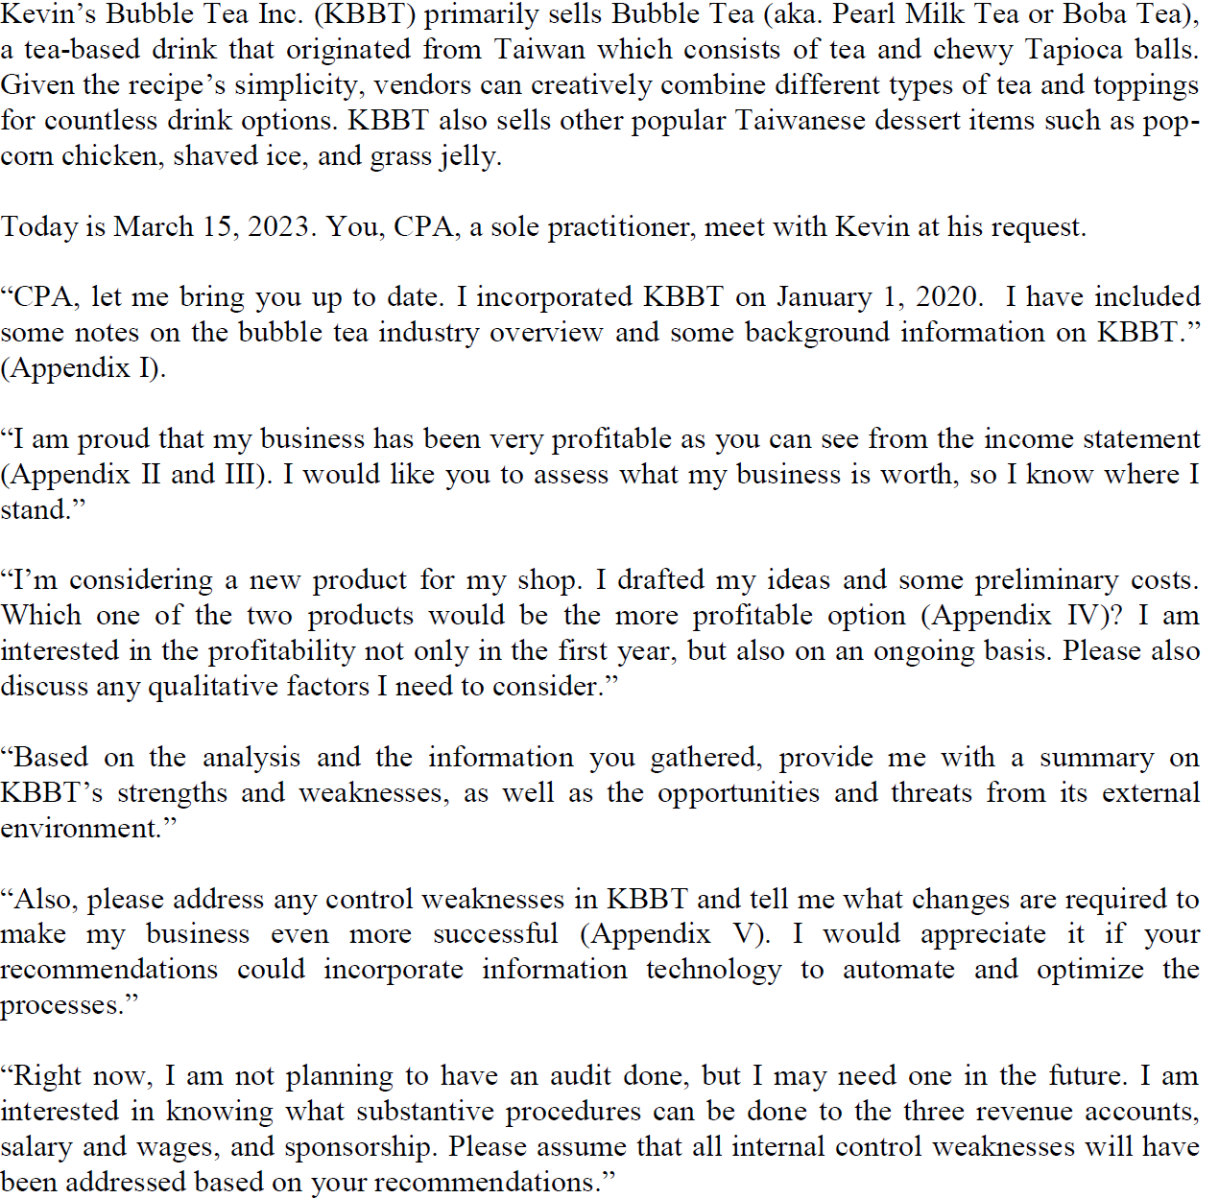
Example of Main Body of case

Slide 10
Description of CFE (cont.)
Breakdown of CFE
CFE is 3 days long
Day 1 – 1 Large 4 hour case – referred to as “Comp” (based on Capstone 1)
Day 2 – 1 Large 5 hour case – Referred to as “Role Comp”
Day 3 – 3 shorter cases each between 70-90 minutes – 4 hours in total - these cases are referred to as “Multi” cases
All cases test more than one competency i.e. subjects

Slide 11
Description of CFE (cont.)
Breakdown of CFE
CFE covers 6 Competencies:
1) Audit & Assurance
2) Financial Reporting
3) Management Accounting
4) Finance
5) Taxation
6) Strategy and Governance

Slide 12
Description of CFE (cont.)
Day 1 of the CFE:
1 large 4 hour case
Based on the case used in Capstone 1 – i.e. same company, 5 or 10 years later
Marked separately from Day 2 and 3
Simple “PASS” or “FAIL”
Not technical – encompasses strategy, governance, SWOT etc.
Notes:
If anyone asks about the pass rate, please tell them:
About 74% overall
Indian students – not tracked or disclosed – most likely less (maybe 40%??) as the skill of case writing takes time to learn
Most important thing for Indian CAs is to follow the program and write the cases. Shortcuts don’t work

Slide 13
Description of CFE (cont.)
Day 2 of the CFE:
1 Case for 5 hours – sometimes referred to as the Role Comp
The case will have financial accounting or/and management accounting issues
– everyone has to address these issues
Students will choose 1 of 4 roles before the CFE and address issues in this role
The 4 roles are: Audit or Tax or Performance Mgmt. or Finance
Therefore, the comp will have 2 or 3 competencies:
Financial accounting or/and management accounting + the 1 chosen role
Notes:
I would not get hung up here re the role choice. Just explain that students have to choose a role, at some point before the CFE and they will understand this more once they write a practice Day 2 case

Slide 14
Description of CFE (cont.)
Day 3 of the CFE:
Each case contains about 4-6 competencies
Everyone writes the same cases – no choice of role
Day 2 and 3 marked together
If unsuccessful – only have to repeat the day(s) that you failed
i.e. if fail Day 1 – repeat day 1 / if fail Day 2/3 – repeat day 2/3

Slide 15
Description of CFE (cont.)
Key Facts About the CFE
Everyone in Canada writes the same CFE exam
3 attempts to pass
Exam written on the computer using word and excel / exam question in paper
form
Exam is open book – you have access to the Handbook and Tax Act on the
computer
Does not matter in which Canadian province you write the exam; you can write the exam in one province and then practice in another province
Notes:
You can write in May, fail and then write in Sept.

Slide 16
2. CASE WRITING AND TECHNICAL
Importance of
Case Writing and Technical
16

Slide 17
Case Writing
Case Writing is essential
The earlier one writes the cases, the better
Studying about a year in advance of the CFE is normal (continue working full time while studying)
Not like the CA in India – students write practice cases while they are studying technical

Slide 18
Technical
2 biggest areas to focus on technical:
Financial Act’g. – ASPE + IFRS
Management Act’g

Slide 19
Technical
New competency for Indian CAs: TAX
Need to know the basics – compliance
Very little tax planning (unless it is your depth role on Day 2)
Know things like:
Computing taxable income
What is deductible?

Slide 20
Technical
Pick up most of the technical from case writing for:
Audit
Finance
Governance

Slide 21
3. PASS INDIAN CAs CFE PROGRAM
PASS
Program for
Indian CAs
21

Slide 22
Who is PASS?
PASS began offering UFE courses in 1989
PASS courses have been offered in all of the large 4 firms – PWC, KPMG, EY and Deloitte and numerous mid-size firms
PASS currently runs the PWC program across Canada
PASS courses are offered across Canada
Michael Levi, co-director of PASS, former Gold Medalist
Consistent excellent feedback from students

Slide 23
CPA PASS Program for Indian CAs
PASS has a course specifically designed for Indian and Other International CAs which includes:
Technical training
Case writing training
Personal counselling

Slide 24
Overall Picture
Self Study | Review Technical binder and watch technical videos – assurance, tax, finance and strategy and governance Watch case intro video and write cases (self mark) – will depend on when you write
Formal Instruction | (a) Write cases. Cases are marked and taken-up live Financial Accounting live-online sessions Management Accounting live-online sessions Technique sessions Personal Counselling
CFE

Slide 25
PASS Program for Indian CAs (cont.)
Technical Study –
Financial and Management Accounting Sessions + Videos
Videos for Other Competencies
May have learned technical many years ago
May not be familiar with tax or financial accounting ASPE
All major topics covered for each competency

Slide 26
PASS Program for Indian CAs (cont.)
Case Writing
Includes:
Self Study: Write and self-mark cases
Formal Instruction:
Write numerous practice Day 1, 2 and 3 cases that are handed in for marking – PASS recognizes that Indian CAs need to write many more practice cases than Canadian students
Combination of live online and video case take-up sessions along with a comprehensive binder with course notes
Technique sessions to teach you how to attack cases successfully

Slide 27
PASS Program for Indian CAs (cont.)
Watch an example of a case take-up: https://youtu.be/JphVdiPhiu4
Watch an example of a technical take- up: https://youtu.be/anEqTg7pBSI

Slide 28
PASS Program for Indian CAs (cont.)
Personal Counselling sessions
Meet with a marker who will go over 3 practice cases with you
Sessions will be held using WhatsApp or Zoom or Skype

Slide 29
PASS Program for Indian CAs (cont.)
Capstone 1 & 2
CAs from India are not required to take Capstone 1 and 2
Capstone 1 ties in with day 1 of CFE - PASS will provide you with the knowledge of Capstone 1 case necessary to succeed on Day 1
Capstone 2 focuses on writing prior CFE cases - PASS provides an alternative to Capstone 2 in which you will write prior CFE cases and have them professionally marked
Alternatively students can mark their own prior CFE cases

Slide 30
Courses for CFE
Courses Provide for Maximum Flexibility
Courses are offered live online
Some sessions offered based on India time (IST)
All sessions are on video – available 24/7

Slide 31
PASS Program for Indian CAs (cont.)
Courses Provide for Maximum Flexibility
Courses are offered live online
Some sessions offered based on India time (IST)
All sessions are on video – available 24/7 (no limits)

Slide 32
PASS Deliverables
The most Comprehensive Course in Canada – Specifically Designed for Indian CAs
The PASS Course includes:
Approximately 30 classes
Over 125 Videos
Approximately 25 cases marked
3 Counselling Sessions

Slide 33
4. PASS SCHEDULES
PASS
Schedules
33

Slide 34
PASS Schedules
Version 1 versus Version 2 (Sept. 2023 CFE)
When you look at the PASS schedules on the PASS website, you will see Version 1 and 2 schedules for the Sept. 2023 CFE
The classes are the same for both versions, except in version 1, cases are written earlier
Unless you register with a short period before the CFE you should choose version 1

Slide 35
Start Anytime
Start Anytime
Indian students can begin anytime, but starting earlier is always advantageous
May 2023 CFE – Could start anytime starting now – best to start no later than
November 2022 if possible
Sept. 2023 CFE – Could start anytime – best to start no later than January 2023 if
possible but earlier is better
Note – A student can sign up for one CFE (i.e. May 2023) and then move to another CFE (i.e. Sept. 2023), without any additional fee to PASS
Notes:
Emphasize starting early is very important and that the Jan. 1 and Apr. 15 are the LATEST dates one should start
Also, emphasize that this process is made for people working full time – most Canadian students work full time while studying. No different for Indian students.

Slide 36
Start Anytime
Hours per Week (suggested)
10 – 15 hours per week (assuming you are working)
Working
Yes – you can work full time while studying for the CFE
Notes:
Emphasize starting early is very important and that the Jan. 1 and Apr. 15 are the LATEST dates one should start
Also, emphasize that this process is made for people working full time – most Canadian students work full time while studying. No different for Indian students.

Slide 37
5. TESTIMONIALS
Testimonials
37
Notes:
Emphasize that PASS deals with more Indian students than any other program and these are just a few of the testimonials

Slide 38
Testimonials
D. Bhavin
As a newcomer and internationally qualified accountant, I had one immediate goal in mind; pass the CPA exam. With about 6 months before the CFE and after being out of school for 14 years, I knew it would be a challenging task, but with PASS it became all the more manageable. I credit most of my success to outstanding study materials and quality live instructions by Michael and Ira. Thank you PASS for helping turn my ambitious goal into a startling reality.

Slide 39
Testimonials
D. Mehta
I am delighted to announce that I cleared the CFE and became a CPA in the first attempt which is a proud moment for anyone. Being a CA from outside Canada (India), it was difficult for me to get used to the way one prepares for CPA. I came across PASS where they have a customized study program for candidates like me and a flexible study program for candidates who are working. With Ira and Michael's guidance and help, I could experience this special moment of my career. The binders, presentations, videos and personal feedback were very helpful in preparing for the CFE. I loved the techniques used for Assurance, Management Accounting and Financial Reporting. Ira and Michael – Thank you very much for everything

Slide 40
Testimonials
S. Fazal
Thank you Ira and Michael (PASS) for your guidance, that helped me pass the CFE in my first attempt. The targeted approach to the exam, made it a lot easier for me to get through the CFE. The study material and in class lectures were of immense help to get command over Case Writing for this level.

Slide 41
6. REGISTRATION AND FEES
Registration with
PASS and Fees
41

Slide 42
Registering with PASS
To register with PASS go to the following URLs (which describes the CFE Course for Indian CAs) and scroll to the bottom to register:
https://www.passyourcpa.ca/package/cfe-indian-and-other-international-cas-currently-not-living-in-canada/
You can get started on your studying as soon as you register

Slide 43
PASS Fees
Fees for PASS Course for Indian and Other International CAs
Students have 2 options:
Take: PASS Course + do not attend PASS Alternative to Capstone 1 and 2
Take: PASS course + PASS Alternative to Capstone 1 and 2

Slide 44
PASS Fees
Fees for PASS Course for Indian and Other International CAs
Option 1: Take: PASS course + do not take PASS Alternative to Capstone 1 and 2
Fee: PASS Course: $1,995 - 15% discount: $1,695
CPA Canada: $250 for Capstone material: 250
$1,945 (Cdn)
With this option students would still write the same number of PASS cases as for the other options but all of the Capstone 2 cases would be marked by the student and not professionally (i.e. by PASS)
Total number of cases marked professionally: 2 Day 2 comps and 8 Day 3 cases

Slide 45
PASS Fees
Fees for PASS Course for Indian and Other International CAs
Option 2: Take: PASS course + PASS Alternative to Capstone 1 and 2
Fee: PASS Indian Course: $1,995 - 15% discount: $1,695
PASS Alternative Course – Capstone 1&2: 680
($800 – 15% discount)
CPA Canada: $250 for Capstone material 250
$2,625 (Cdn)
This option is an ideal option, as it covers all of the bases and gives you a huge amount of case writing experience with professional markers; in total you would write and have professionally marked: 2 Day 1 comps, 4 Day 2 Comps and 16 Day 3 cases (22 total cases)

Slide 46
PASS Fees
Fees for PASS Course for Indian and Other International CAs – Full Program
Regardless of the Option chosen payment is generally made through a credit card – if not possible alternate arrangements are made
If it is difficult to pay the full amount upfront, an instalment plan with zero interest is available

Slide 47
Total Fees to Obtain the Canadian CPA
The total fees to obtain the Canadian CPA are approximately $4,000 US, as follows:
Cdn $
PASS Course $1,945*
One time registration application fee – CPA Ont. 125
Annual student fee – CPA Ont. 600**
CFE fee 1,500
Total cost if already in Canada 4,170
Travel to Canada to write the CFE – approx. 1,500
Total Cost if Living in India $5,670 (approx $4,100 US)
* Assumes that option 1 chosen and includes cost of course as well as Capstone 2 material purchased from CPA Canada ($1,695 + 250)
** Fee would be approx. half if you remain in India and do not practice in Canada

Slide 48
7. REGISTERING WITH A CPA PROVINCIAL INSTITUTE
Registration with CPA Provincial Institute
48

Slide 49
Registering with the CPA Canadian Institute
In order to write the CFE you would register with CPA Ontario if you are planning to live in Ontario and CPA Western School of Business (CPAWSB) if you are planning to live in a western province (i.e. B.C., Alberta, Saskatchewan or Manitoba)
We recommend that you register immediately (after consulting with the respective Institute to ensure it is not too late), if you plan to write the CFE in May 2023 as you must be registered before you can write the CFE and it can take significant time for your registration to be processed, particularly by CPA Ontario
If you plan to write in September 2023 do not register until January 2023 to avoid paying any fees for the 2022 year
After registering with an institute you need to register to write the CFE approximately 3 and a half months before the CFE
Notes:
Tell them Ontario takes 8-12 weeks to register a student, so they have to get in their documents to start the process. Once the process is started, they will be okay to write, even if the deadline is coming up.

Slide 50
Registering with the CPA Canadian Institute (cont.)
You can start the PASS course immediately – you do NOT have to be registered with the Canadian CPA Institute to start with PASS. Registration with CPA Ontario can take between 8 - 12 weeks; Registration with CPAWSB is quicker
Notes:
Tell them Ontario takes 8-12 weeks to register a student, so they have to get in their documents to start the process. Once the process is started, they will be okay to write, even if the deadline is coming up.

Slide 51
Registering with the CPA Canadian Institute (cont.)
Regardless which Province you register with, you can work/practice in any Province
You will, however, write the CFE in the province in which you register – so if you are planning to move to Canada before you write, register in the Province in which you are planning to live
Notes:
It really makes no difference which Province they register with, but Ontario is most familiar with Indian student, followed by BC.
The ONLY impact of which Province they register with, is that you write the CFE in that Province. It does not matter where they will live or work.

Slide 52
Registering with the CPA Canadian Institute (cont.)
Useful Links CPA Ontario and CPA Western School of Business
Ontario
https://www.cpaontario.ca/contact-us
https://www.cpaontario.ca/become-a-cpa/why-cpa/internationally-trained-accountants/member-of-specified-accounting-body
https://www.cpaontario.ca/become-a-cpa/why-cpa/internationally-trained-accountants/moving-to-canada

Slide 53
Registering with the CPA Canadian Institute (cont.)
Useful Links CPA Ontario and CPA Western School of Business
CPA Western School of Business
http://www.cpawsb.ca/contact-us
https://www.cpawsb.ca/future-learners/apply-for-admission-to-cpawsb/mou-members/
https://www.cpacanada.ca/en/become-a-cpa/international-credential-recognition/international-recognition-agreements/international-members-seeking-canadian-cpa/india-cas-seeking-canadian-cpa-designation

Slide 54
8. CONTACTING PASS
Contact Information
54

Slide 55
Contact Information
For Inquiries about the PASS Course
Contact: PASS in Canada
Michael Levi mjlevi@passyourcpa.ca
1-416-560-3797 (whatsApp)
Skype: live:mjlevi_2
Ira Walfish iwalfish@passyourcpa.ca
1-416-888-7173 (whatsApp)
Skype: ira.walfish
Visit our website: www.passyourcpa.ca
Notes:
Please tell them if they have additional questions, they should Whats APP Michael or Ira (tell them to remember the time difference)
We are always answering student’s questions, so they have ongoing support

Slide 56
PASS Support
PASS Support
We understand that students have questions (for both students in Canada and India not familiar with the program)
Both Michael and Ira are available by e-mail and whatsApp to answer questions and provide guidance
“I thank you and Michael for your continued guidance, support and prompt responses to any questions I ever had” J. Hussain

Slide 57
3 Most Important Take-aways
3 most important take-aways from this session:
This process is totally doable while working full time – in India or elsewhere
Start writing cases as early as possible – practice is critical so make sure to write all of the cases used in the formal portion of course and additional self study cases if you have time
Technical review is critical but you don’t need perfect technical before you start the case writing – you can learn some of the technical from the case writing

Slide 58
Other PASS Info Sessions to Watch if You are Living in India
IMMIGRATING TO CANADA
https://youtu.be/RUL78H0NtiA
LIFE IN CANADA
https://youtu.be/ng3o4z1cSSM

